Slide 1
Working in an Existing Document and Using Microsoft Word
Part 2 of the Series “Duxbury Braille Translator: from First Paddle to Flocking Flying”
Notes:
Layout: Title Slide

Slide 2
Description
What is a practical workflow for transcribing using Duxbury Braille Translator? Attend this second in a series of four webinars which provide a structured introduction to Duxbury answering the essential questions, like: Which file do I need? What does Microsoft Word have to do with Duxbury? and How many ways can I use six-key entry with Duxbury? Through step-by-step instruction, you will learn how to save and navigate braille files efficiently. This second session builds on the information in the first session, “My First Document.”

Slide 3

Hello
Kyle DeJute
Braille Trainer at APH
Notes:
Layout: Comparison

Slide 4
View Codes
Notes:
Layout: Section Header

Slide 5
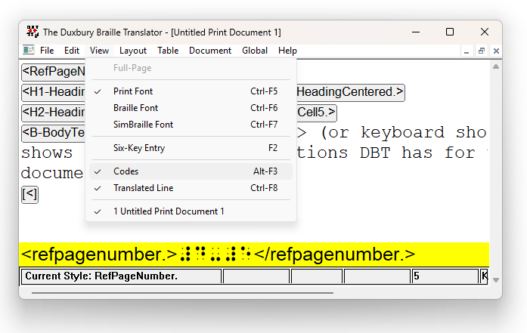
Alt + F3
File > View Codes > (or keyboard shortcut Alt F3) shows or hides the instructions DBT has for the content of a document.

Slide 6
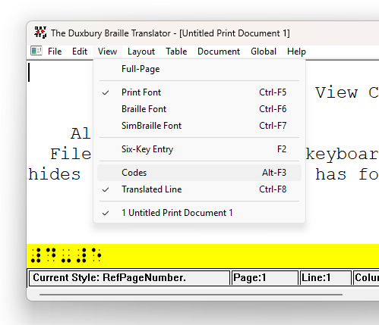
View Codes Is a Toggle
Notes:
JAWS command: Alt + 7 - (on top number row) - Reads the translated line.

Slide 7
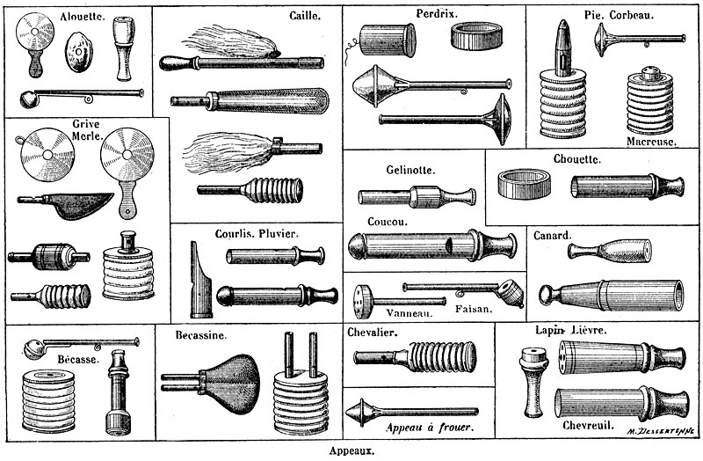
Duck Call
Use DBT documentation to find out what those revealed codes mean and do.
DBT Codes Quick Reference 💪

Slide 8
What Was “My First Document?”
Notes:
Layout: Section Header

Slide 9
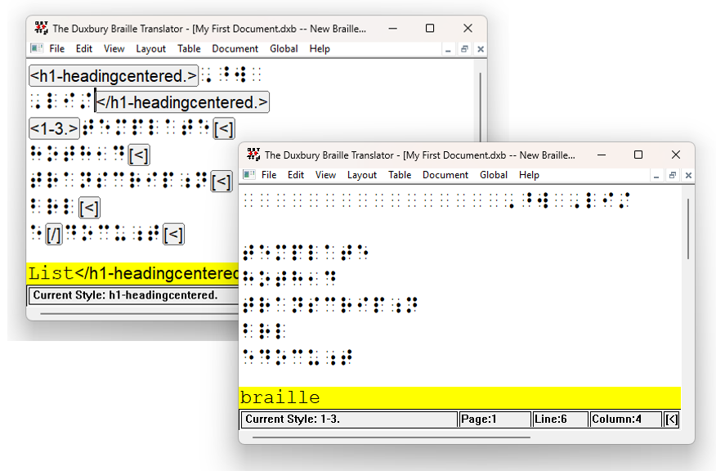
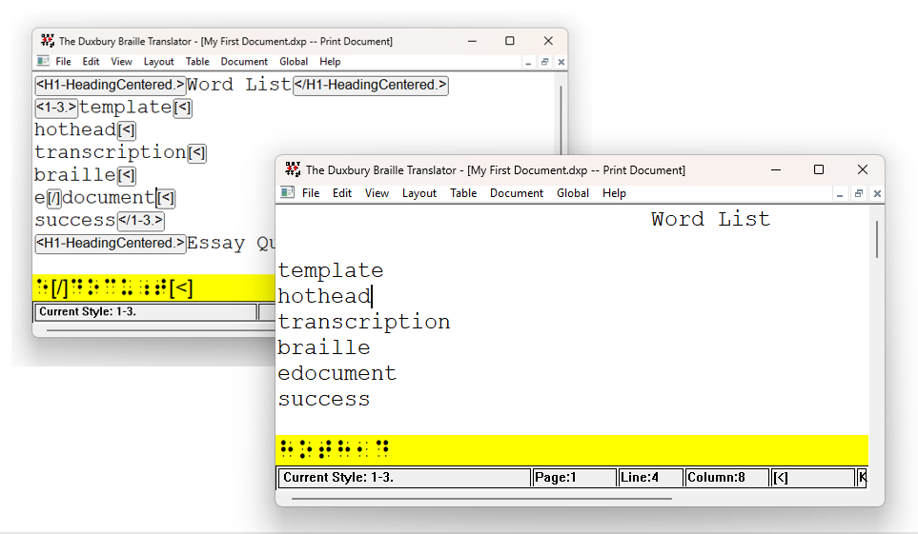
Peek at My First Document

Slide 10
Demonstration and Practice
🦆

Slide 11
Opening an Existing Document
distinction between DXB and BRF
how to view styles and codes
Teaser: opening a non-DBT file through DBT

Slide 12
Distinction between DXB and BRF
DXB – Duxbury Braille
BRF – Braille Ready File
Includes codes & styles
ASCII characters in Simbraille font
Can be a working file in a single code
Best read by DBT
No codes or styles
Hard spaces, line breaks, page breaks, ASCII characters
Often for embosser
Easily readable by multiple software programs, including text editors

Slide 13
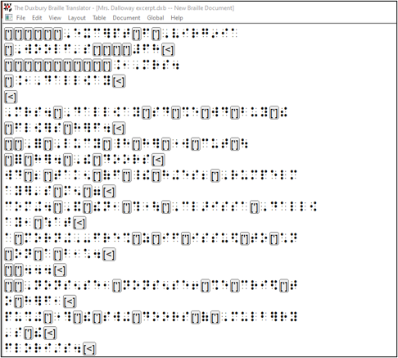
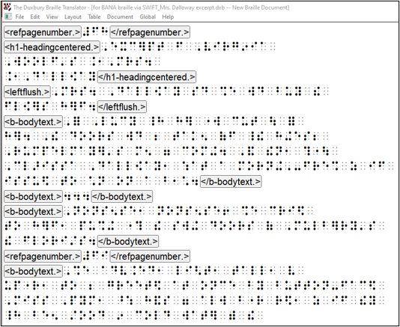
BRF and DXB File Views
Notes:
But, look! The file name says dot! D! X! B!

Slide 14

Poll Time! #1
It is time for a poll/quiz!

Slide 15
Poll One!
1. Which option best completes the following sentence? “View Codes” affects ____.
A. the main document
B. the translated line
C. both the main document and the translated line

Slide 16
Poll One, the Answer!
1. Which option best completes the following sentence? “View Codes” affects ____.
A. the main document
B. the translated line
*C. both the main document and the translated line*

Slide 17
A Very Important Setting in DBT

Slide 18
The Very Important Setting
Open the Duxbury program. Do not open a document.
From the "Global" dropdown menu, choose "Formatted Braille Importer...".
Check the box next to "Read formatted braille without interpretation." Click OK.
Read formatted braille without interpretation

Slide 19
Why is this setting so important?
Allows a finely tuned file to remain finely tuned.
For more, see “Importing Formatted Braille Files” under “3: Starting to Use DBT” in the Duxbury DBT On-line documentation

Slide 20

Read formatted braille WITHOUT interpretation

Slide 21
Poll Time! #2
It is time for a poll/quiz!

Slide 22
Poll Two!
2. True or False? Every braille file active in Duxbury Braille Translator (DBT) is a .dxb file.
A. True
B. False

Slide 23
Poll Two, the Answer!
2. True or False? Every braille file active in Duxbury Braille Translator (DBT) is a .dxb file.
*A. True*
B. False

Slide 24

What About My Second Document? Third? …
What about embossing?
How about other file types? Other workflows?
Why is scanning so varied?
…

Slide 25
Poll Time! #3
It is time for a poll/quiz!

Slide 26
Poll Three!
4. What do you think a QWERTY keyboard is?
A. a computer keyboard where the most common consonants and vowels are on the home row, except for the letter u
B. a computer keyboard based on the first typing layout, invented to complement the typewriter
C. a keyboard instrument that is supported by a strap around the neck and shoulders, similar to the way a guitar is held

Slide 27
Poll Three, the Answer!
4. What do you think a QWERTY keyboard is?
A. a computer keyboard where the most common consonants and vowels are on the home row, except for the letter u
*B. a computer keyboard based on the first typing layout, invented to complement the typewriter*
C. a keyboard instrument that is supported by a strap around the neck and shoulders, similar to the way a guitar is held

Slide 28
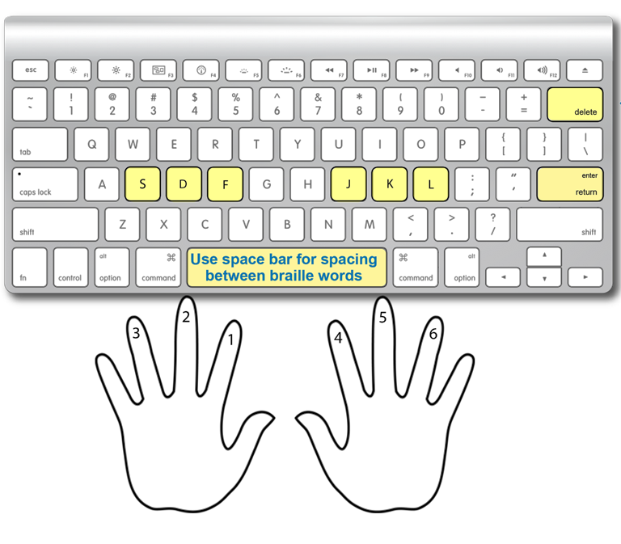
QWERTY Keyboard
image from UEBOnline’s page Using the Keyboard
Notes:
You can test the six-key capabilities (n-key rollover) of your keyboard in the page “Six Key Input” (for testing keyboard) in APH’s UEB Math Tutorial: https://uebmath.aphtech.org/sixdot

Slide 29
Working In Braille Documents
Notes:
Layout: Section Header

Slide 30
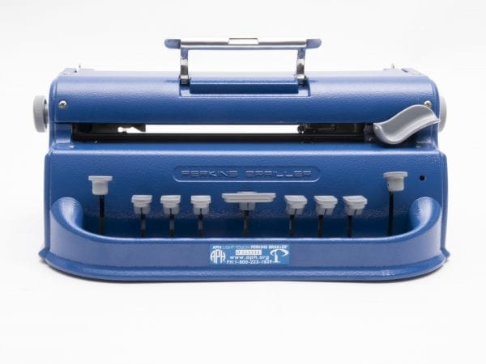

We Love Six-Key Entry

Slide 31

Braille Writing Practice
Perky Duck
  their siblings or cousins (BrailleZephyr, APH online tutorials, UEBOnline, refreshable braille displays, etc.)
Use s d f j k l

Slide 32

DANGER! DXB Editing and Chaos
Remember each Duxbury file is UNconnected to others.
So, once you are editing in a braille file, you are stuck there.

Slide 33

*You* Are Using DBT

Slide 34
Poll Time! #4
It is time for a poll/quiz!

Slide 35
Poll Four!
5. Which keys of a QWERTY keyboard are the usual defaults for six-key entry?
A. sdfjkl
B. weruio
C. tgvyhb
D. ⠠⠠⠟⠺⠑⠗⠞⠽

Slide 36
Poll Four, the Answer!
5. Which keys of a QWERTY keyboard are the usual defaults for six-key entry?
*A. sdfjkl*
B. weruio
C. tgvyhb
D. ⠠⠠⠟⠺⠑⠗⠞⠽

Slide 37
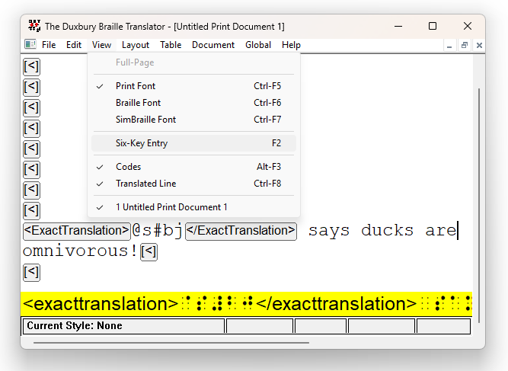
Six-Key Entry in Print in DBT
F2 to toggle six-key entry (or View > Six-Key Entry)
ExactTranslation, or similar, to get the cells and not interpretation of the signs
With great power comes great responsibility!

Slide 38
Duck Call (repeat)
Use DBT documentation to find out what those revealed codes mean and do.
DBT Codes Quick Reference 💪

Slide 39
Working From Word

Slide 40
One Quick Checklist, Word to DBT
Get original file
Open Word, and choose template on Braille tab
Get content from original file into Word file
View formatting
Remove unnecessary formatting
Apply styles and other transcription tools
SWIFT

Slide 41
Demonstration and Practice in Word
🦆

Slide 42

The “Braille Tab” on Word’s “Ribbon”
The “ribbon” combines menu bar and toolbar into a single floating pane.
The first time you run Word after installing SWIFT, you are presented with the Options dialog. After that, Word’s ribbon includes a tab called “Braille.”
See Duxbury’s page on SWIFT for more, including detailed documentation for SWIFT!

Slide 43
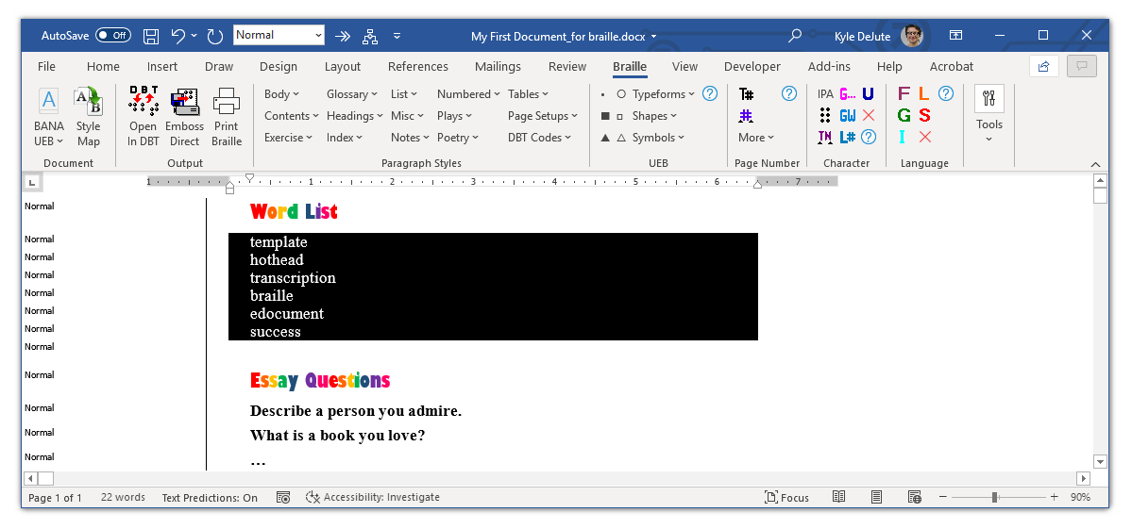
A Braille Tab in the Wild

Slide 44
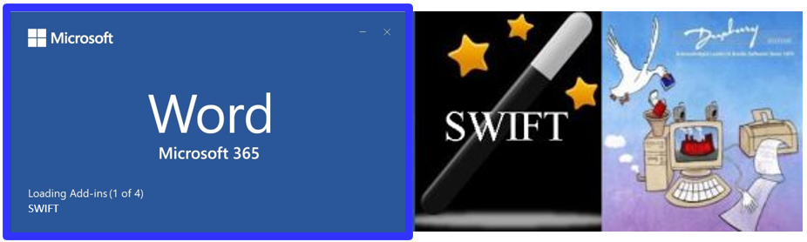
What is SWIFT?
It is an Add-in from Duxbury
SWIFT is an acronym made from the description (Send Word file Immediately For Translation)
Notes:
Might be described as a “bridge” between Word and DBT

Slide 45
Word Is Not Required to Use DBT

Slide 46
File Management
Whatever your workflow, as you transcribe, remember:
Keep file names clear
Name files consistently
Beware clones of all kinds
  Same name, different location
  “File Name (copy)”
  “File Name (9,999,999)

Slide 47
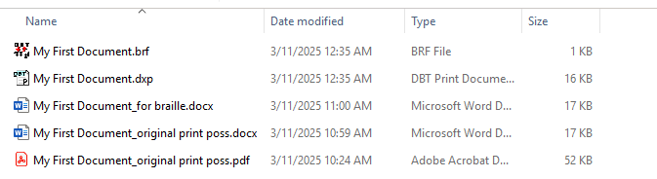
Multiple File Types
One practical workflow is to save each file type along the way in your transcription.

Slide 48
Poll Time! #5
It is time for a poll/quiz!

Slide 49
Poll Five!
3. True or False? A .brf file can only be opened by Duxbury.
A. True
B. False

Slide 50
Poll Five, the Answer!
3. True or False? A .brf file can only be opened by Duxbury.
A. True
*B. False*

Slide 51
"Word"s of Advice

Slide 52
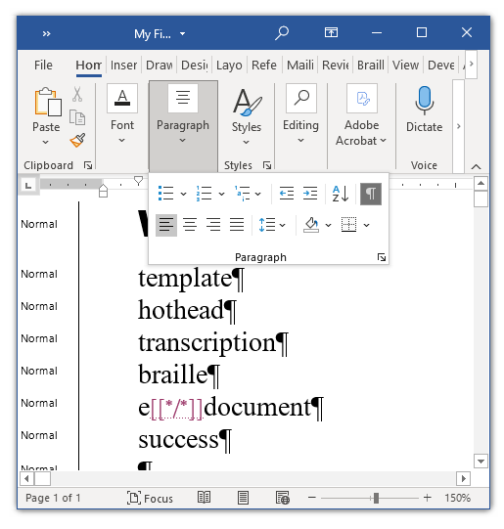
Show Formatting
Show formatting marks – like spaces, pilcrows, tabs, …
by pressing the pilcrow ¶ in the Paragraph group of the Home tab or pressing Ctrl + * (or, possibly, by pressing Alt, H, 8)

Slide 53
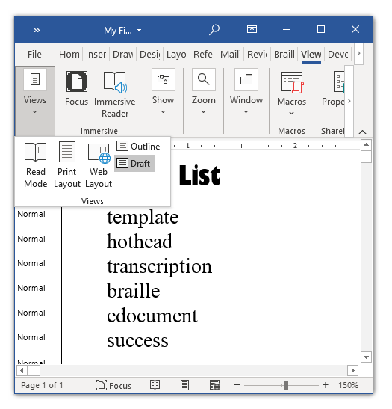
Choose Draft View
If it has not happened automatically (e.g., when you chose a template in the Braille tab), then you can see what styles are in the document in “Draft View.”

Slide 54
Poll Time! #6
It is time for a poll/quiz!

Slide 55
Poll Six!
6. Who maintains the “Braille” tab that appears in Microsoft Word’s Ribbon?
A. Microsoft
B. Duxbury
C. Extraterrestrials

Slide 56
Poll Six, the Answer!
6. Who maintains the “Braille” tab that appears in Microsoft Word’s Ribbon?
A. Microsoft
*B. Duxbury*
C. Extraterrestrials

Slide 57
Endless Array of Resources (Many Controls in the Cockpit)

Slide 58
Codes, Guidelines, and Explanations
ICEB homepage: https://www.iceb.org/
BANA’s page on Braille Formats 2016: https://brailleauthority.org/braille-formats-principles-print-braille-transcription-2016
NBA webinar “The DOs and DON’Ts of Typeforms”: https://www.nationalbraille.org/resources/webinars/the-dos-and-donts-of-typeforms/

Slide 59
Foundations of Duxbury
Remember that other webinar exists. It covers at least:
codes
styles
Help menu
Duxuser [and DuxAnnounce] and contacting Duxbury
checking your version and license before contacting Duxbury
Duxbury documentation

Slide 60
Poll Time! #7
It is time for a poll/quiz!

Slide 61
Poll Seven!
7. Who maintains the program SWIFT (Send Word file Immediately For Translation)?
A. Microsoft
B. Duxbury
C. Louis Braille

Slide 62
Poll Seven, the Answer!
7. Who maintains the program SWIFT (Send Word file Immediately For Translation)?
A. Microsoft
*B. Duxbury*
C. Louis Braille

Slide 63
Objectives
Explain two differences between a DXB and a BRF file.
Explain what it means that SWIFT can make the “Braille” tab appear in Word’s “ribbon.”
Identify which keys of a QWERTY keyboard are traditionally used for Perkins brailler-style six-key entry.

Slide 64
Contact information
Kyle DeJute, kdejute@aph.org
Notes:
Layout: Comparison

Slide 65
Other Parts of This Series
My First Document, recording now on APH’s YouTube channel
Today (March 18, 2025): Working In an Existing Document and Using Microsoft Word
April 15, 2025: Getting Good at Editing
May 20, 2025: Macros and Math

Slide 66
BONUS CONTENT
Some More Questions and Suggestions From “Foundations of Duxbury,” 2022

Slide 67
Is it sometimes better to edit the DXB rather than the DXP? …

Slide 68
The Workflow That Works Works!
… Personally, I prefer work with dxb file. It allows me to edit and proofread a document on my Braille display at the same time.
I hear you that it is rather more intuitive to edit a DXB instead of a DXP. If that workflow gets you the braille that you need in the timeframe you need, then it is probably the right fit for you, and I am not here to tell you to use DBT differently than the way that is working for you.
If you decide to experiment with using a DXP instead of a DXB as your working file, please let me know. And, regardless, braille on! 😀

Slide 69
Is there a cheat sheet to know what style to apply?

Slide 70
DBT Resources for Code and Style Information
I cannot point you to a cheat sheet or overview page of DBT styles.
You can look into what codes make up the styles in whatever DBT template you use. Within DBT, you can see what codes make up a given style by highlighting that style in the Modify Style tool in DBT (Document > Modify Style…). DBT’s documentation includes some explanation on their page Document: Modify Style.
Once you know what codes make up a given style, you can look up what effect those codes have in the DBT Codes Quick Reference.
I hope that helps at least a little!
Notes:
Those links are to the 14.1 documentation. Other online documentations exist though!
Like the ones for 12.7:
Document: Modify Style
DBT Codes Quick Reference

Slide 71
How do I get started with SWIFT? (SWIFT is Duxbury’s free program “Send Word file Immediately For Translation;” it’s what makes Word have a “Braille” tab)

Slide 72
Download and Follow Instructions
The first step in downloading SWIFT is to visit Duxbury’s page on SWIFT.
Before you download, check what version of Duxbury you have. As the page linked above says, if you have an older version of DBT, then you might need SWIFT 4.0.
Choose the version of SWIFT that is appropriate for your DBT version. (You can find your DBT version information in “Help > About DBT”)
Read all the instructions and explanations given in the page linked above, and let your CT (or IT) department or me know if you have questions.

Slide 73
DuxUser Email List

Slide 74
There is always more to learn!
The information below is taken from Duxbury’s page on User Discussion Groups.
“The Duxuser forum is an Internet email listserv that is open to Duxbury users, or others potentially interested in becoming Duxbury users, for sharing of ideas and to seek advice on matters beyond routine technical support. Duxbury posts notices of interest to Duxbury users, including the electronic edition of its newsletter (Duxuser) and prompt detailed information about all releases (even minor updates), to Duxuser.
To subscribe to duxuser, send a blank message to duxuser-request@freelists.org with "subscribe" (without the quotes) in the subject line. Alternatively, one may visit www.freelists.org and subscribe, unsubscribe, or change subscription options at any time via the "login" page. List archives may also be viewed at that site.
There is no need to join both Duxuser and Duxnews, because any information that we post to Duxnews would also be posted to Duxuser.”
The DuxUser archive is an enlightening place to search for topics of discussion.

